Slide 1
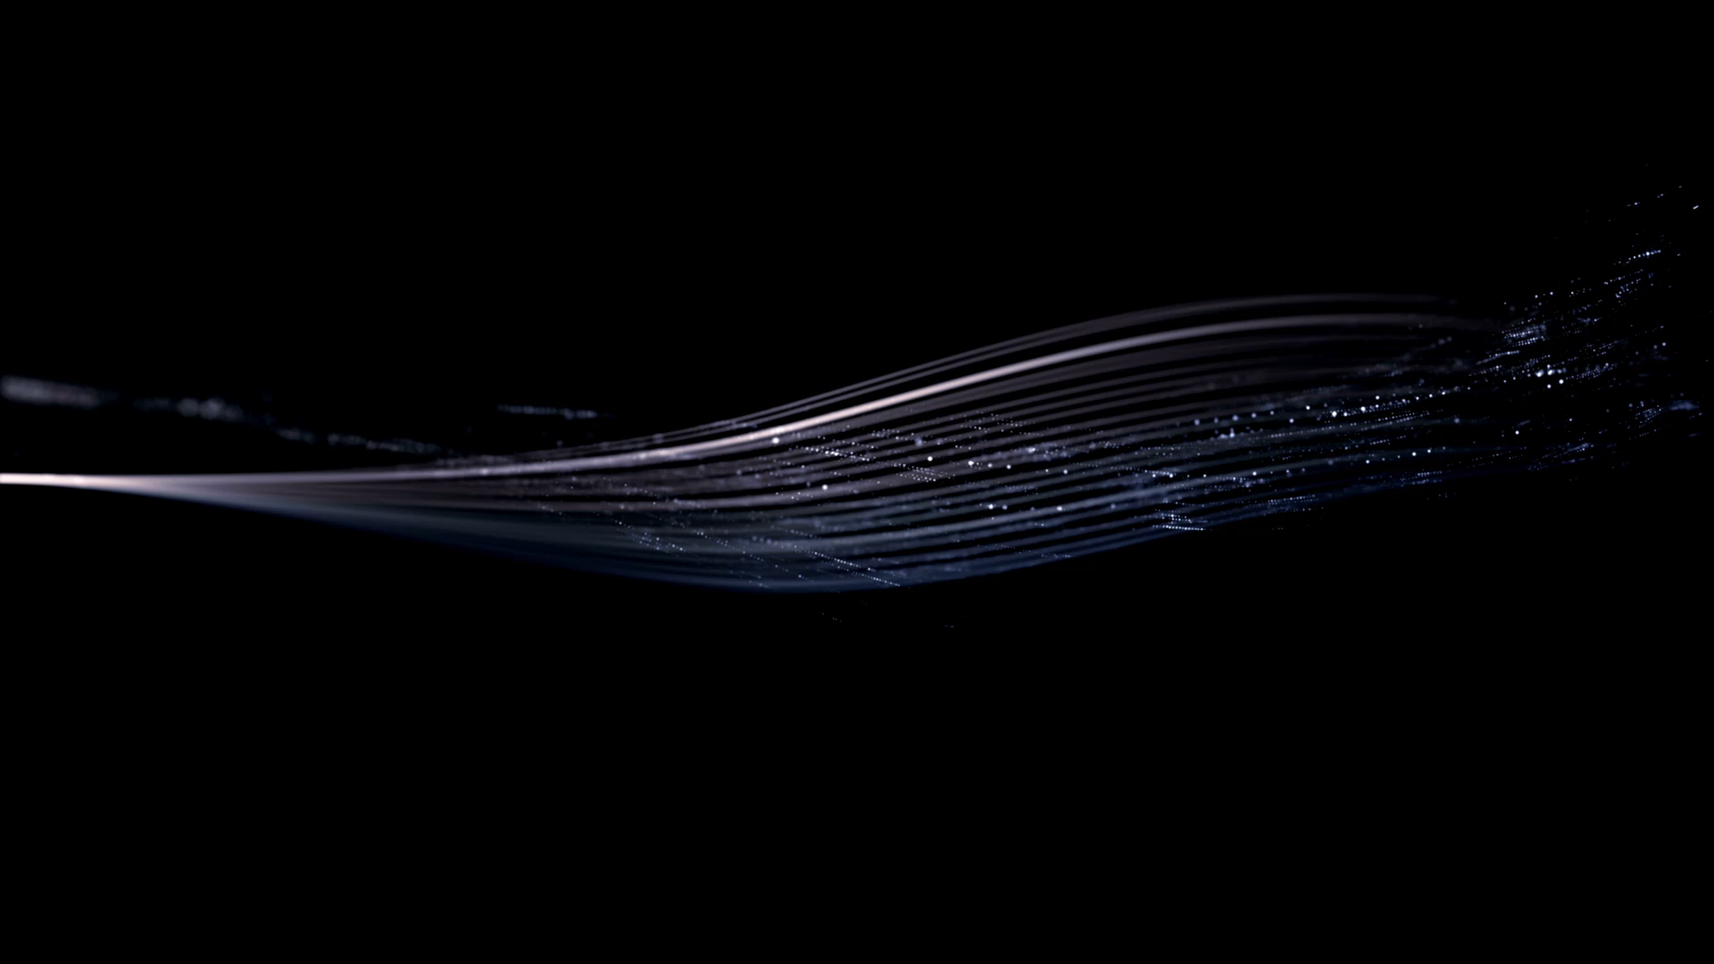
WAVEMIXSR
By:
21023P- Jayakumar W.S.
210027C – Alahakoon U.M.Y.B.
Pixel perfect

Slide 2
What is SUPER RESOLUTION?
Super-resolution (SR) refers to a family of techniques in image processing aimed at enhancing the resolution of an image
We take a low resolution image and enhance it to a high resolution image.
The goal is to predict the missing details that were not captured
SR can be achieved through traditional interpolation methods like bicubic or nearest-neighbor techniques
Deep learning has revolutionized this field

Slide 3
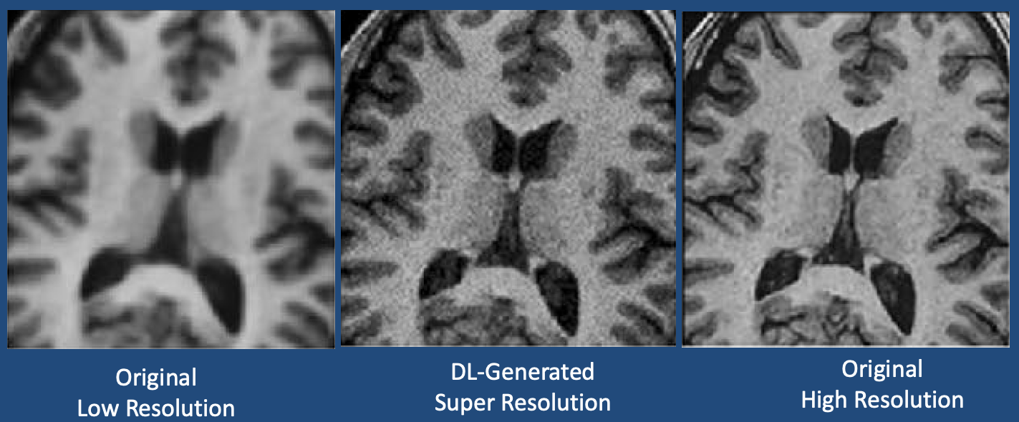
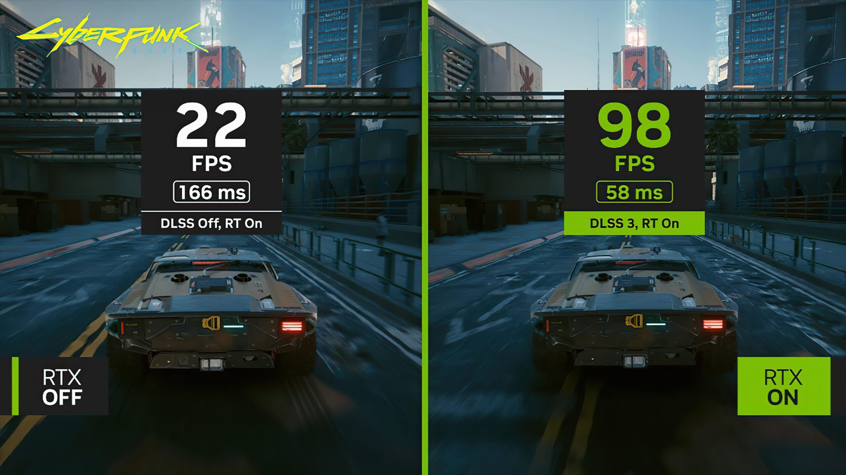
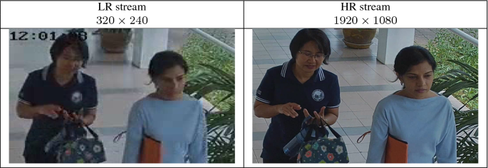
Applications of SUPER RESOLUTION?

Slide 4
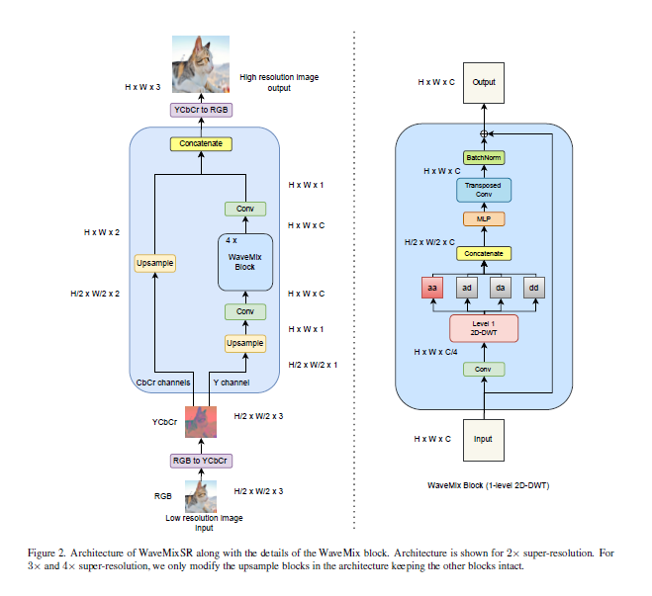
ARCHITECTURE

Slide 5
WAVELET TRANSFORM
Wavelet transform is a mathematical tool that decomposes a signal into different frequency components while also providing information on where or when these frequencies occur.
For an image it can provide details on where sharp changes and smooth changes take place

Slide 6
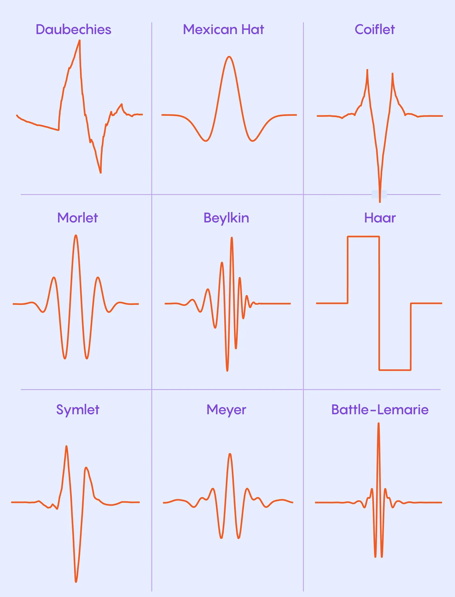
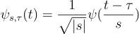
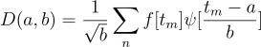

WAVELET TRANSFORM
Where $ψ(t)$ is called the mother wavelet.

Slide 7
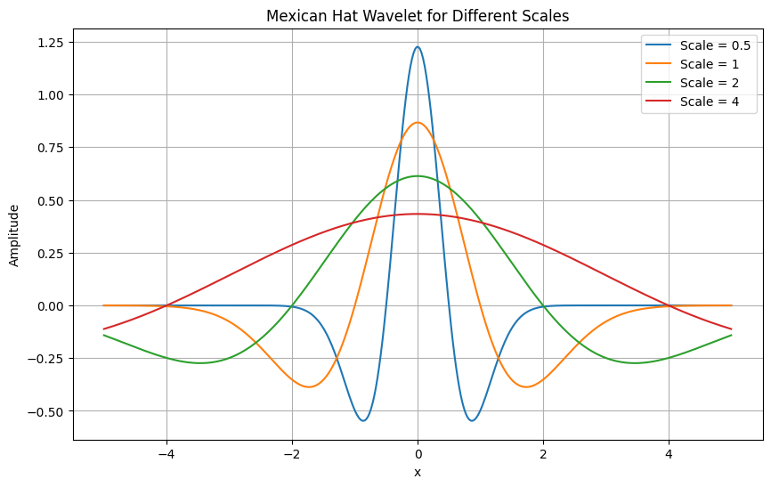
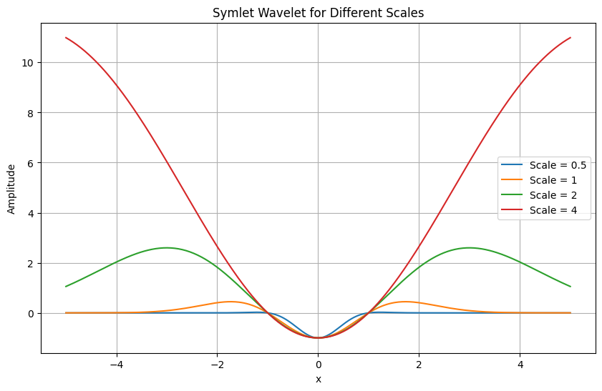
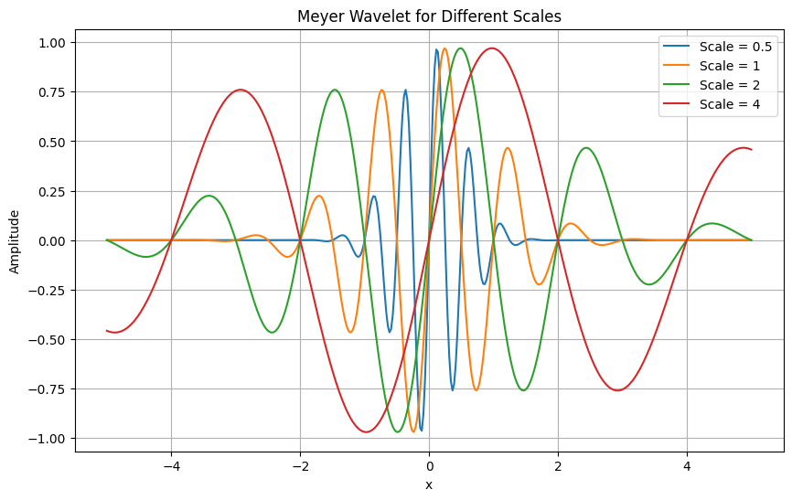
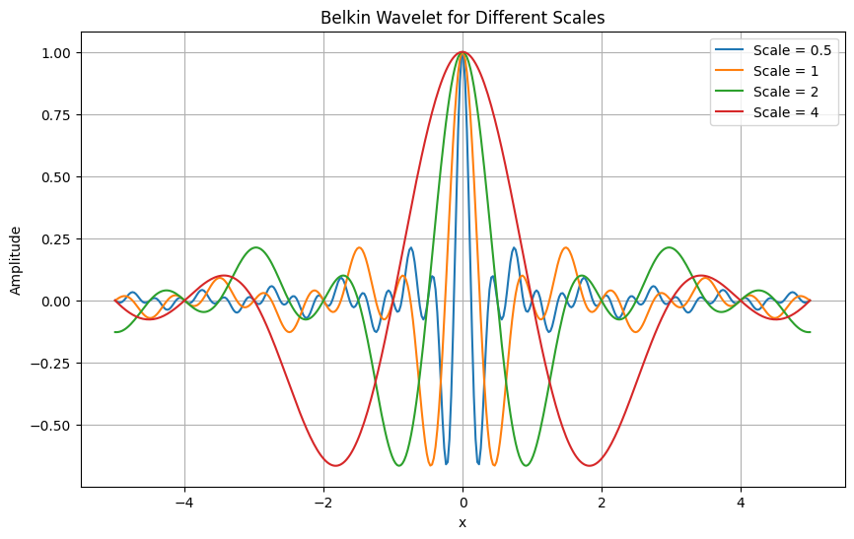

Slide 8
SMALL VS LARGE SCALING
Large scaling can be used to capture low frequency coarse parts of an image
It highlights more global features like large shape and general brightness variations
Small can be used to capture high frequency components or fine details in the image
It can detect sharp transitions and local patterns like edges and textures.

Slide 9
TRANSPOSED CONVOLUTION
Transposed convolution is a way to reverse the down-sampling effect of a regular convolution.
It increases the spatial dimensions of the input.
This is achieved by inserting zeros between elements of the input feature map before applying the convolution operation.
The size of the output feature map depends on several factors, including the stride, padding, kernel size, and input dimensions.

Slide 10
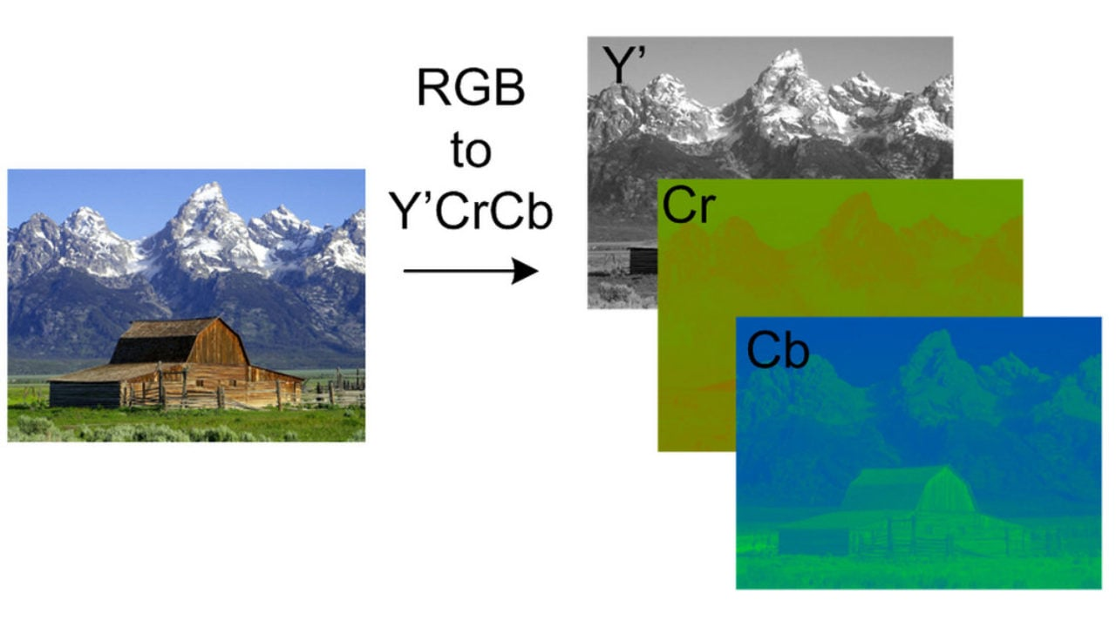
DISCUSSING THE ARCHITECTURE
Convert the image to YCrCb colour space

Slide 11
DISCUSSING THE ARCHITECTURE : Y component
Upsample using bicubic interpolation
Convolutional layer
Wavemix block
Convolutional layer

Slide 12
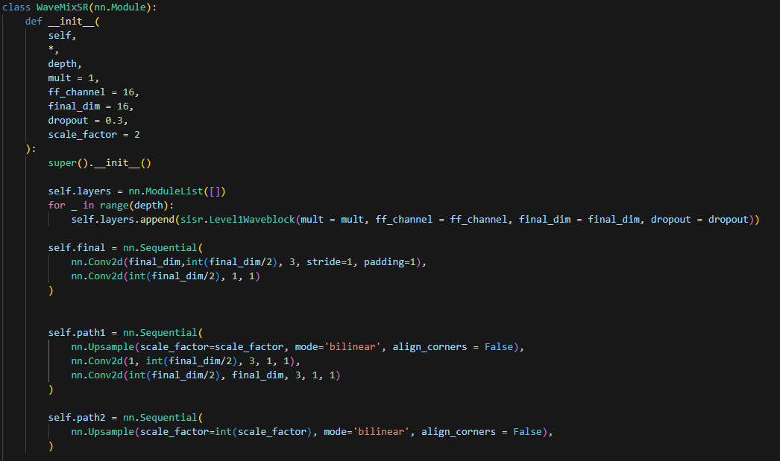
Code

Slide 13
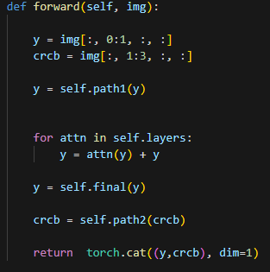
Code

Slide 14

DISCUSSING THE ARCHITECTURE : WAVEMIX BLOCK
Convolutional Layer
4 Wavelet transforms $w_{aa}, w_{ad}, w_{da}, w_{dd}$ where $a$ stands for approximate and $d$ stands for discrete.
Such transforms can capture low and high frequency components in both horizontal and vertical directions.
All 4 wavelet transforms are concatenated and sent to a MLP block
Next transposed convolution is performed.

Slide 15
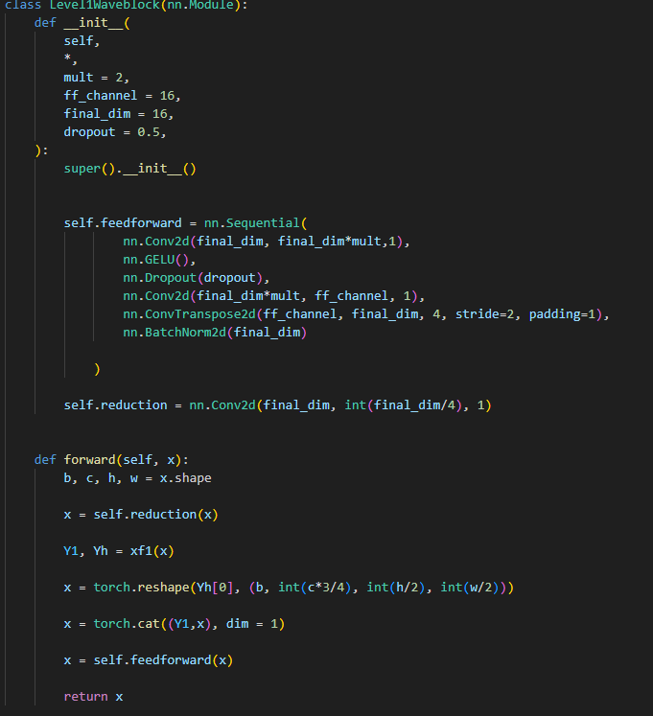
Code

Slide 16
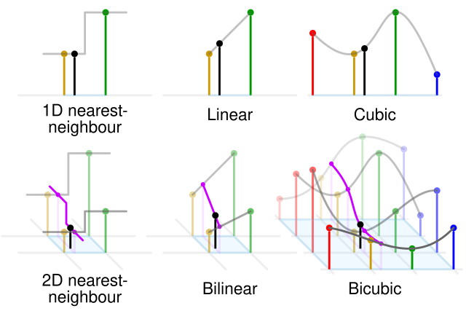
DISCUSSING THE ARCHITECTURE : CbCr channels
Upsample using bicubic interpolation
Concatenate with Y channel

Slide 17
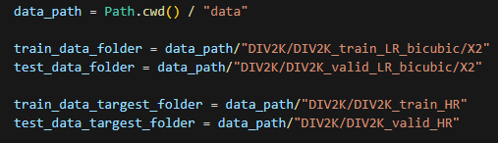
Code

Slide 18
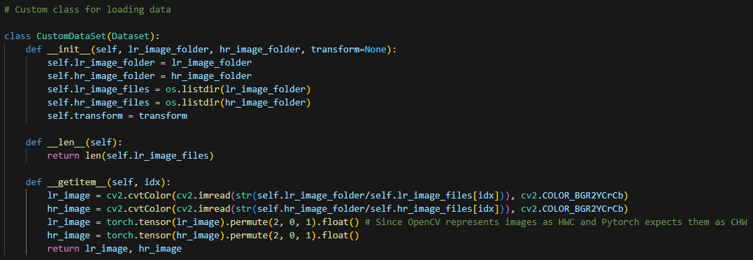
Code

Slide 19
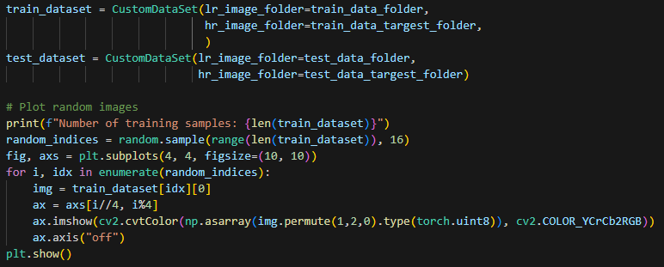
Code

Slide 20
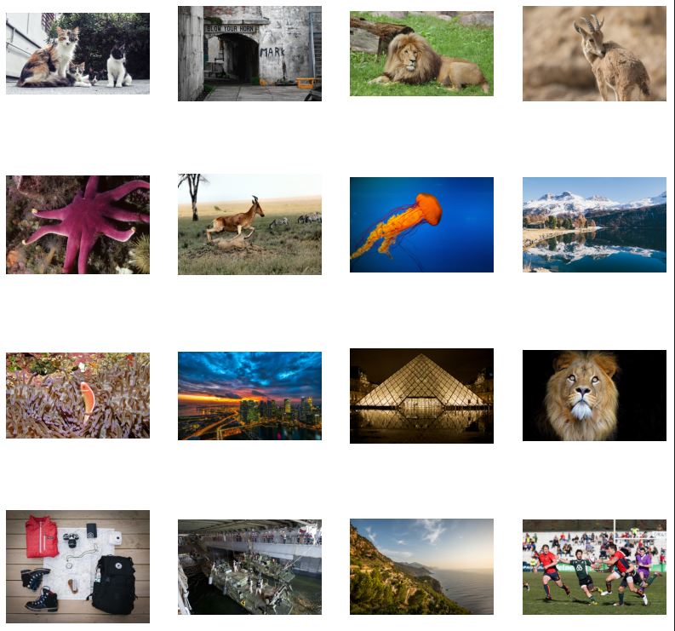
Code

Slide 21
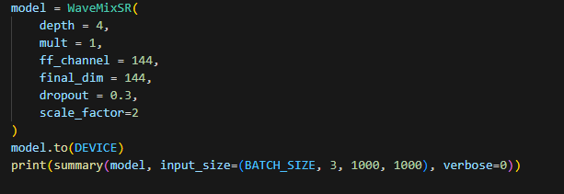
Code

Slide 22
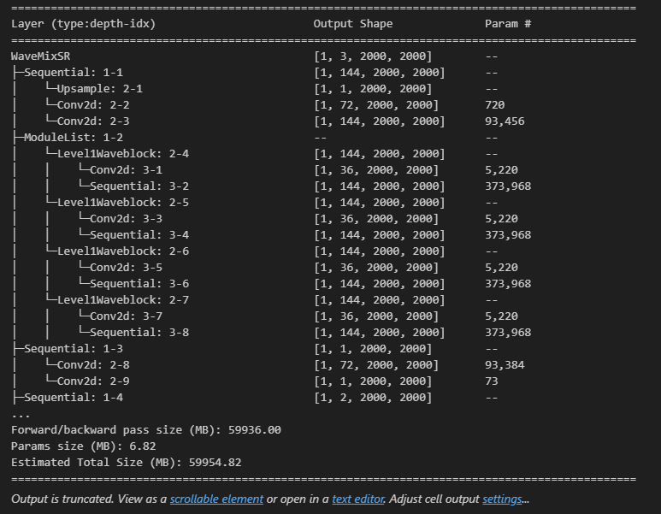
Methodology
Attempted to train the model

Slide 23

Methodology
Obtained pretrained model and loaded it to run inference
Code for running inference was coded by us

Slide 24
Results
Inference was run on the test subset of the DIV2K dataset.
We ran inference on images that were down sampled using different techniques such as bicubic, mild, difficult, wild and also some unknown techniques.
We compared them against existing up sampling techniques such as bilinear interpolation, nearest neighbor and bicubic interpolation

Slide 25
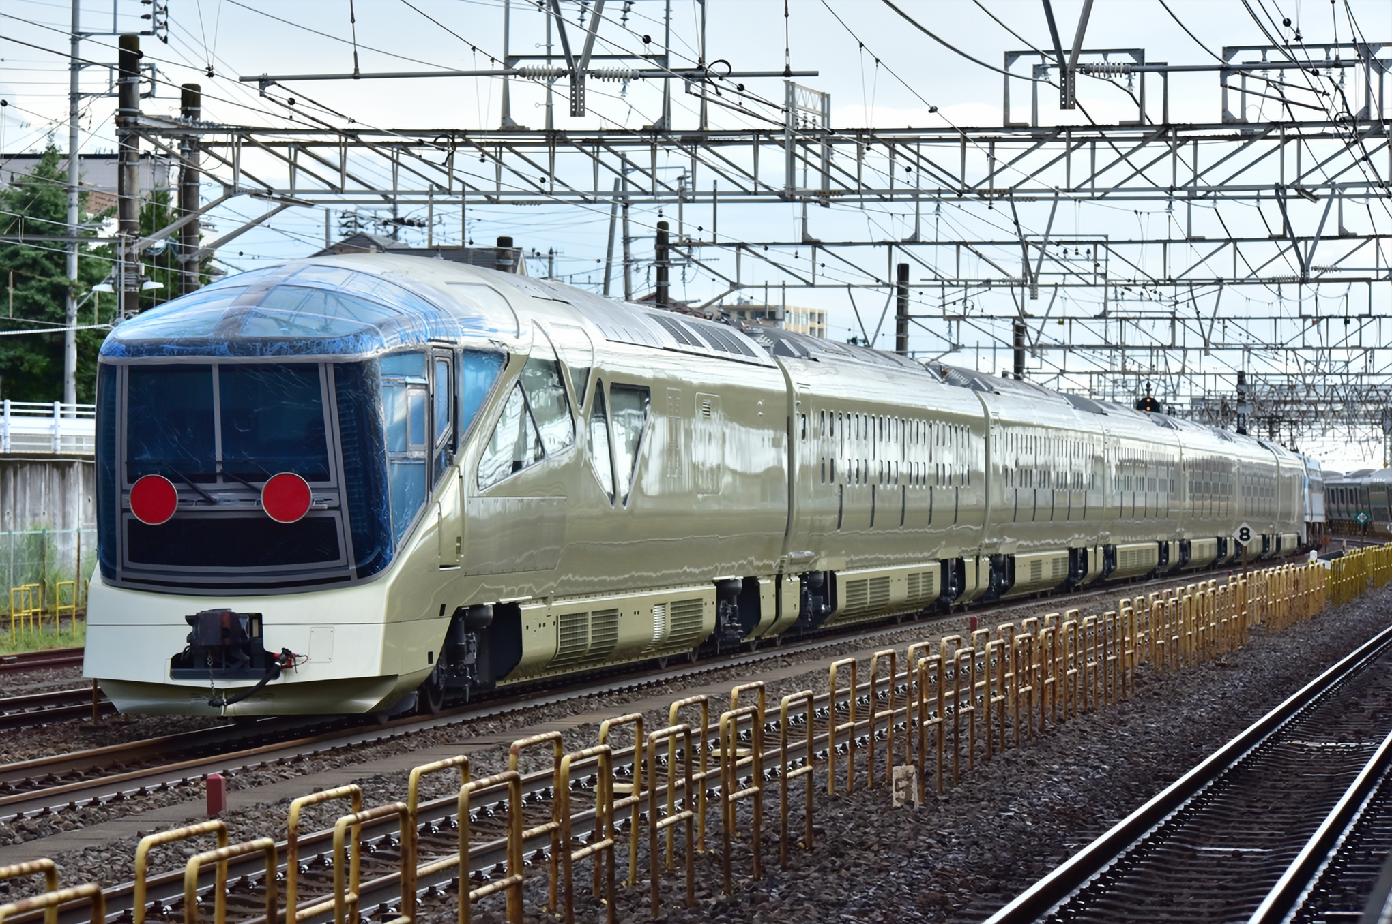

Slide 26
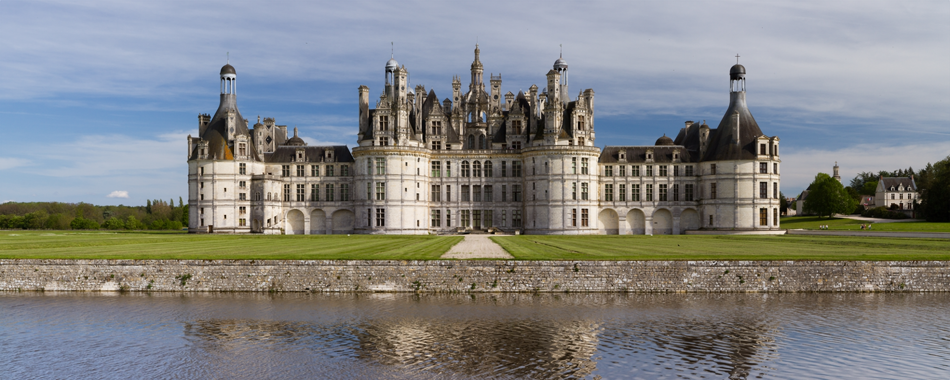

Slide 27


Slide 28


Slide 29
RESULTS: Mse loss
Image | MSE Bilinear | MSE Bicubic | MSE Nearest N. | MSE Wavemix
0804 | 85.610879 | 63.311168 | 100.479395 | 41.902860
0809 | 20.134811 | 11.800485 | 28.491521 | 7.892705
0820 | 184.990433 | 128.118131 | 219.422703 | 56.260582
0846 | 185.966193 | 142.388565 | 199.560043 | 71.988089
0850 | 71.835322 | 56.801367 | 78.044734 | 32.280629
0855 | 52.386281 | 40.660039 | 58.252612 | 31.054350
0866 | 130.443994 | 102.415332 | 137.248531 | 85.694887
0869 | 198.582595 | 158.899287 | 195.781864 | 103.219478
0874 | 48.817761 | 37.551371 | 52.999818 | 24.792822
0888 | 50.707544 | 36.718218 | 68.505541 | 24.075763

Slide 30
Extension 1
We tested the model on upscaling a video.
Different types of videos were tested.
While the performance was better than traditional upscaling methods, improvements can be made

Slide 31
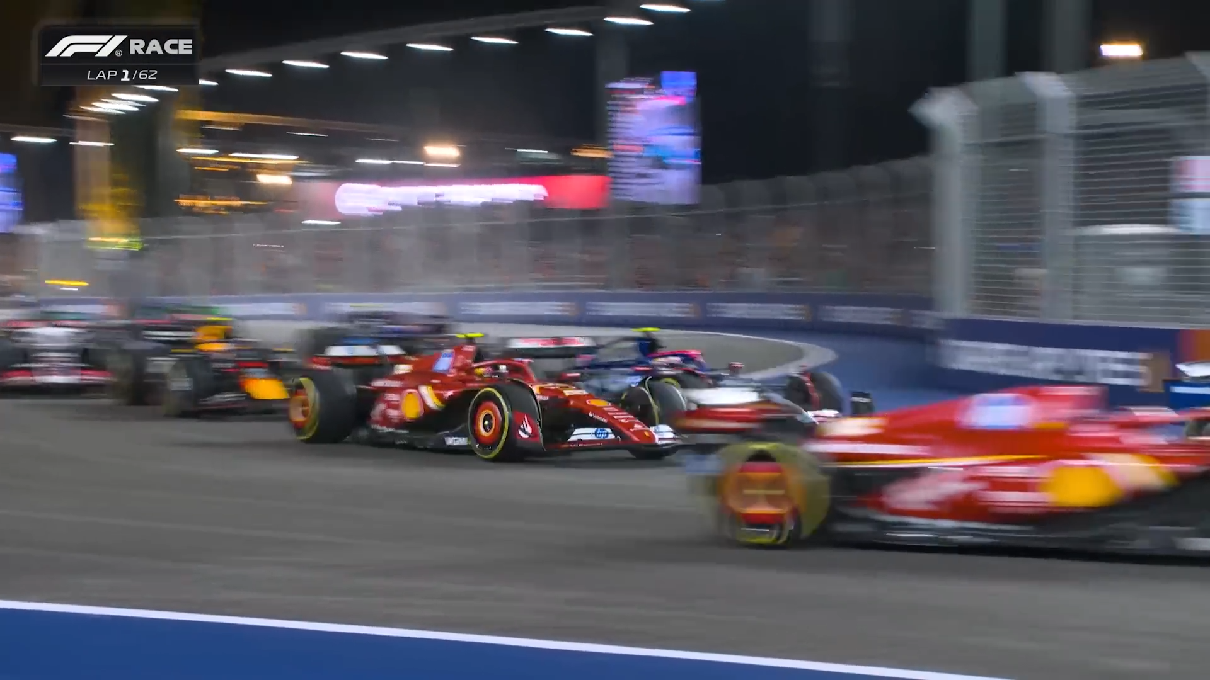
Extension 1

Slide 32
Extension 1
Identify Keypoints with SIFT
Divide Frame into Static and Dynamic Regions based on feature matching
Apply WaveMixSR to Static Regions
For dynamic regions: use a separate model to deblur these parts eg: VRT: Video Restoration Transformer
Using SIFT estimate motion vectors for dynamic parts
Add motion blur based on motion vectors

Slide 33
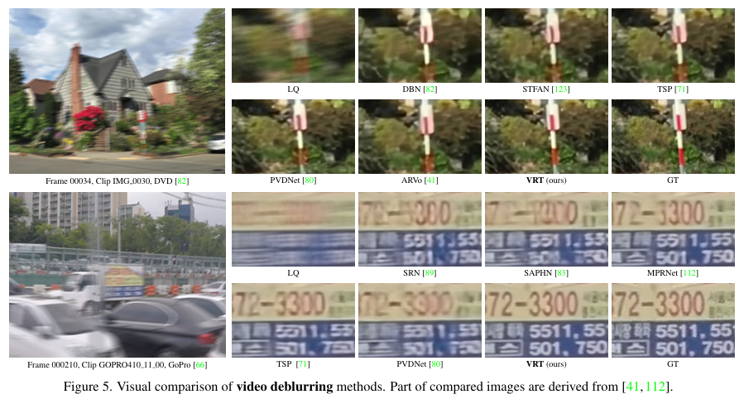

Slide 34
Extension 2
Utilizing pixelshuffle instead of transposed convolution.
Pixelshuffle is more efficient than transposed convolution.
Pixel shuffle increases the resolution and decreases the dimensionality
It also removes block artifacts from transposed convolution

Slide 35

Extension 2

Slide 36
CONCLUSION
The model performs as expected and upscales images as required.
It’s performance is better than traditional methods
Extensions for video upscaling and efficiency are possible

Slide 37
THANK YOU

